Slide 1
Viral Reduction Assay

Slide 2
Week 1
01/08 – 09/08

Slide 3
Step 2: Viral Production Calculation – Main changes
When making this, I ran everything for NJ1.csv and NJ2020.csv since this last one has multiple stations

Slide 4
Source File for Step 2
Consist of general setup and all the functions needed to calculate viral production
vp_calc_functions.R + sourcesourcebaby.R => viral_production_step2_source.R
Beginning of script has some general information about current step and checks if all the necessary packages are installed

Slide 5
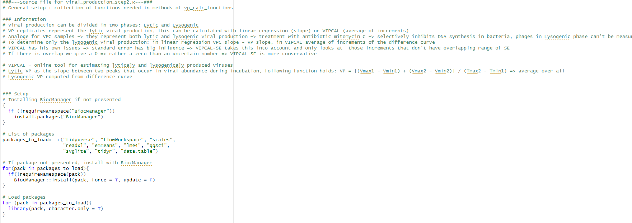

Slide 6
Main changes in functions
Determine timepoints: tp()
Linking of colnames to colvalues simplified with for loop
Main comment: a lot of functions had rm()-statement in the end of the function to delete variables. But since these are defined in the function and not in the global environment these won’t be returned => no need to delete them

Slide 7
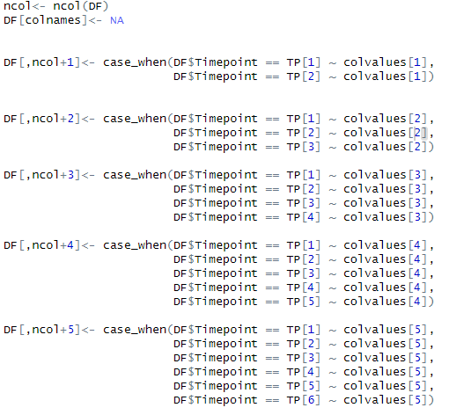
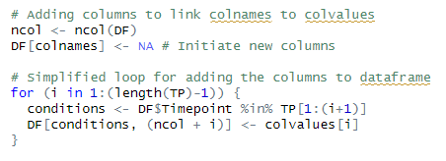
More general with for-loop => also if in the future more timepoints are available then this is automatically taken into acccount

Slide 8
2. Separate and Average dataframe functions: df_SR() and df_AVG()
Made one function that consists an option to add the timepoints (add_tp), for all the methods this was the case so default: add_tp = T => only for the bacterial_endpoint it was set to false
Tried to change gather to pivot_longer because I read that online that pivot_longer was more recent, but there were problems with the arrange line and the order of the output dataframe so I sticked with gather()
When trying with bigger dataset just find mistake of df_list that was not in my code
Gather() with index instead of names since select in previous step assures us the correct order of columns

Slide 9
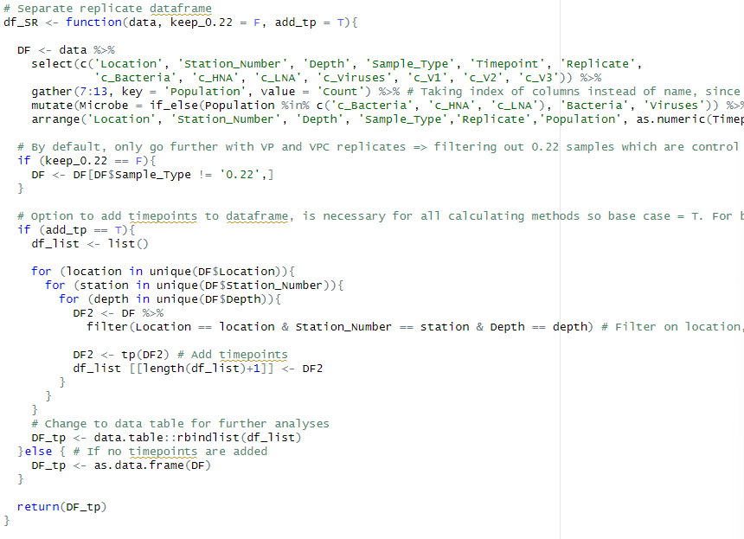

Slide 10
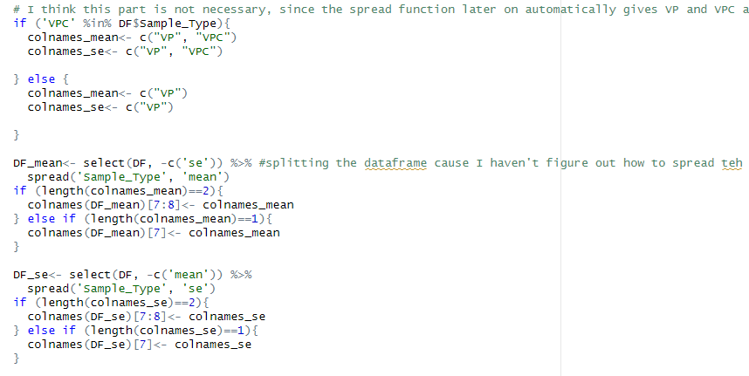
Spread() in df_AVG gives automatically VP and VPC as colnames for mean and SE resp.
This part of the code is not necessary. My function doesn’t have this part and all same results are obtained

Slide 11
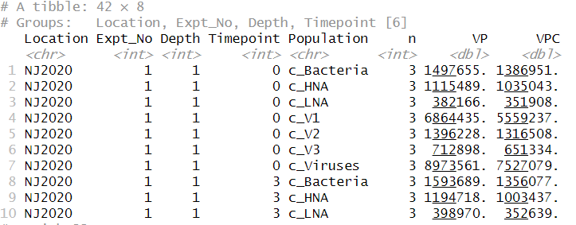
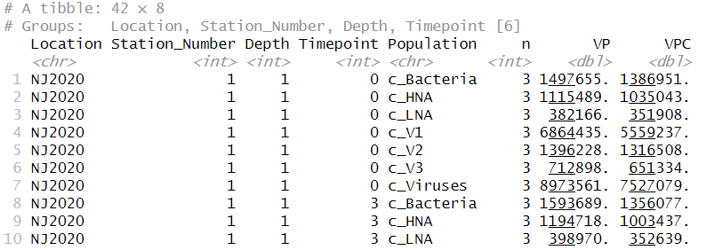

Slide 12
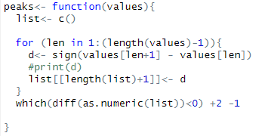
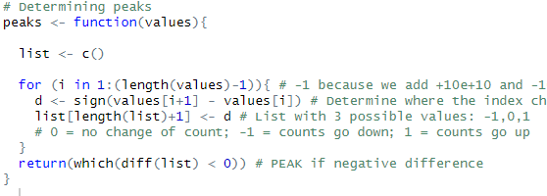
3. Peaks and valleys: peaks() and valleys()
Saving all the results in a nested list and then when looking at the difference as.numeric => just save values as a list of numerics
You do +2 -1 which is just +1 and then later on in the VIPCAL functions you determine peaks but subtract 1 so first you add 1 and then remove 1?

Slide 13
4. LMER model: LMER_model()
First tried to not include the change of replicates for VPC samples => all same results were obtained except the SE of the diff samples => but indeed to distinguish between samples for the model this is necessary
No main changes here, just gave the function a bit more structure

Slide 14
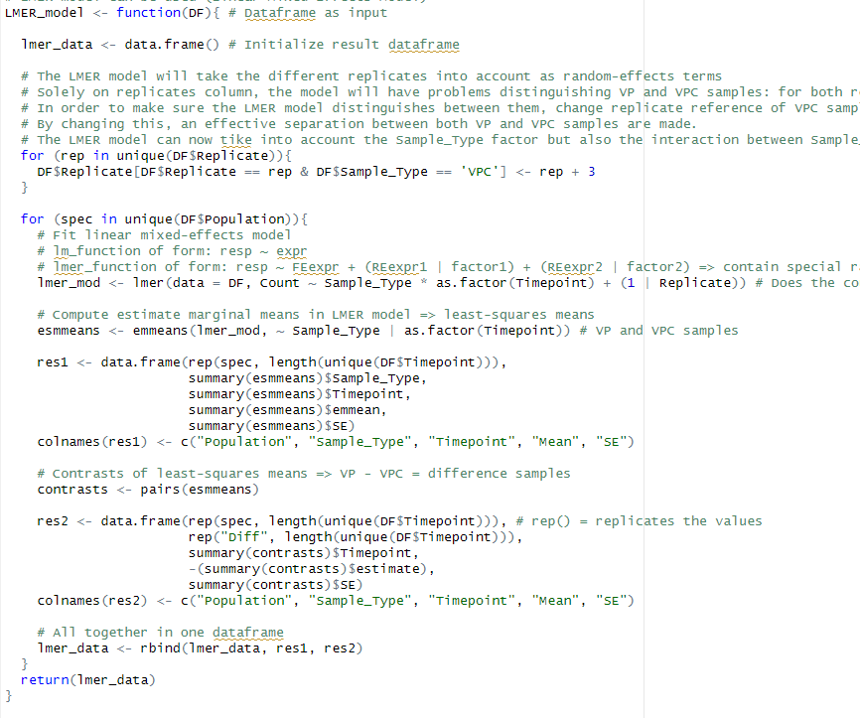

Slide 15
5. Slope functions Linear Regression: slope_LM_...()
Main small thing: initiate data.frame at beginning of function but later on data.frame(t(sapply(lm,c)) => first initiation is not necessary
No general changes in these 4 functions
In the one with LMER model: don’t think those try()statement and following if df4 exists is necessary => I got same results without these
There is probably a way to make one general slope_LM and one general VIPCAL function and again distinguish the different scenarios => Definitely, keep the 12 separate functions for each method!

Slide 16
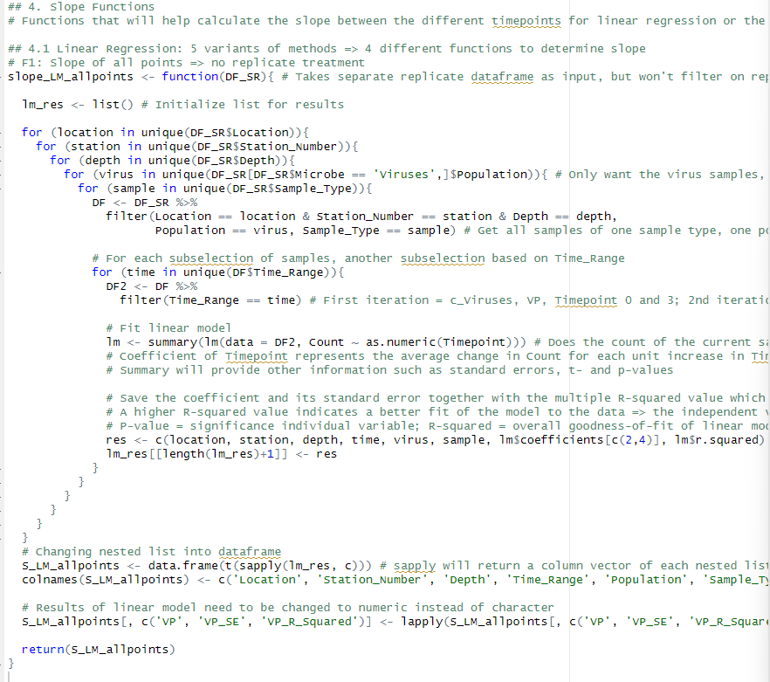
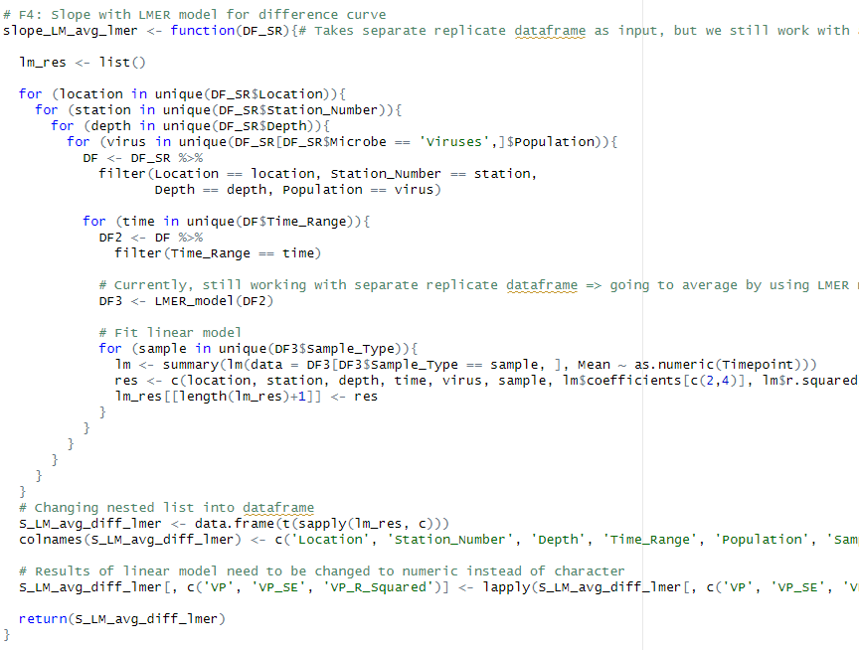

Slide 17
6. VIPCAL functions: VIPCAL_...()
Again, the same with the data.frame initialization and try statement=> is just a small thing
In the calculation of peaks and valleys -1 is not necessary if you change the peaks and valley’s function and don’t add one there
Calculation of viral production optimized with 1 if-else statement and for loop through different peaks instead of manually if-elseif and so go through different values of p. If somehow in future data more then 3 peaks are found then the for-loop takes care of those

Slide 18
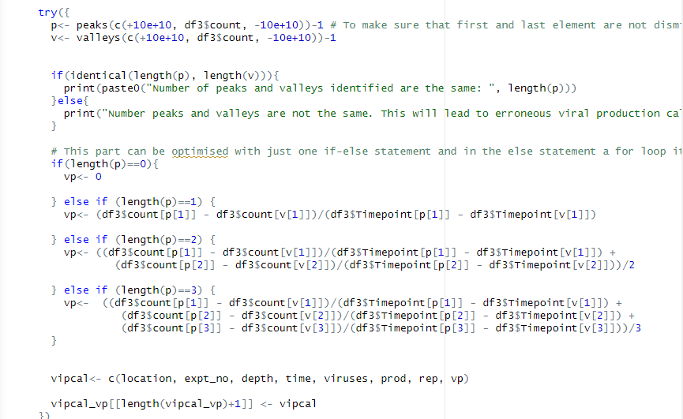
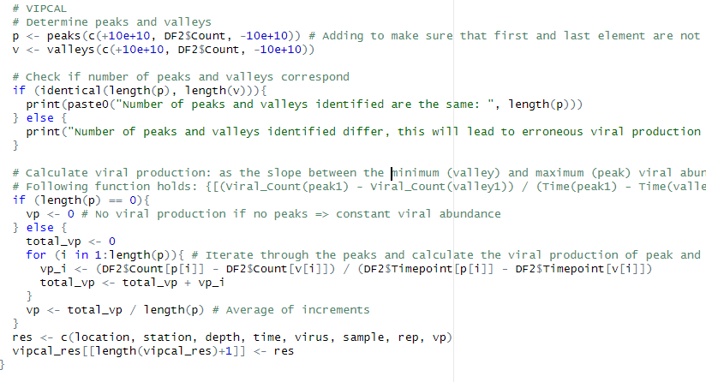

Slide 19
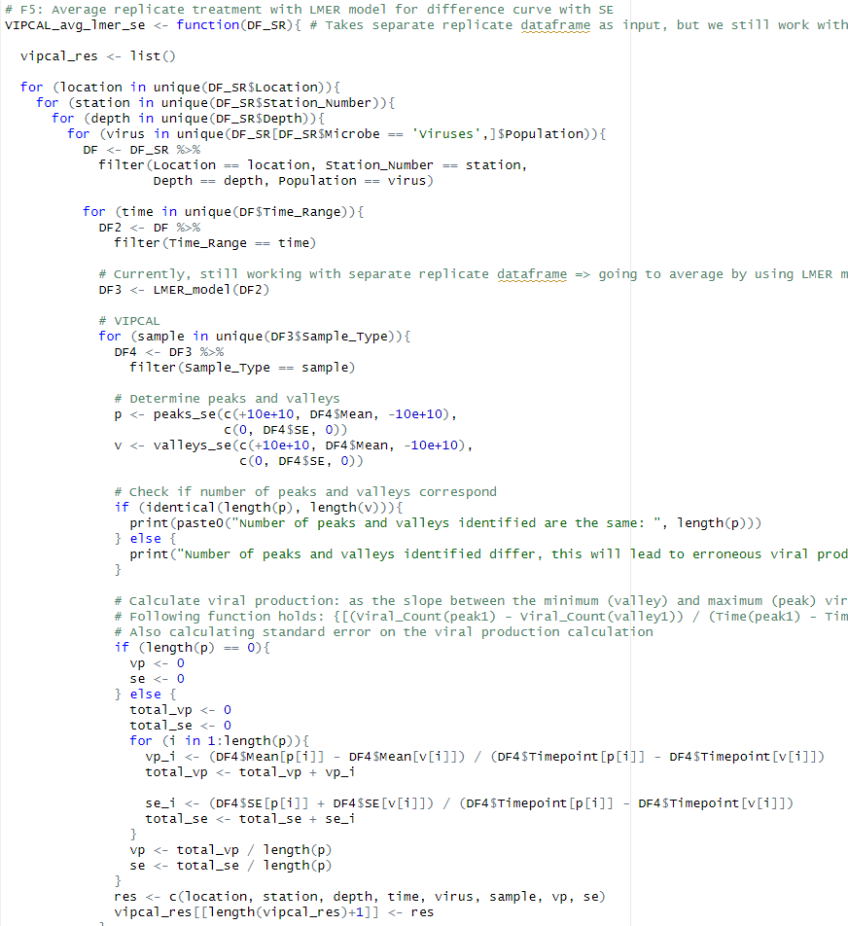
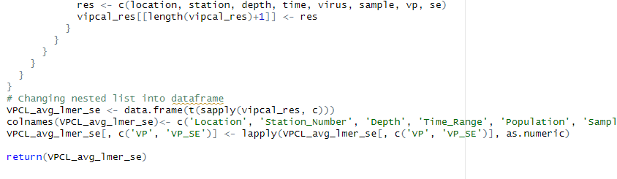

Slide 20
7. Calculate Lysogenic production: calc_DIFF()
First thing I saw, is that the current four functions are all in general doing the same => made 1 functions that holds all cases instead of 4 separate functions
Also, in one of the vipcal methods there was a mistake that SE wasn’t taken into account => is fixed now
Making of dataframe on the basis of dplyr: group_by and summarize instead of as.data.frame(cbind())

Slide 21
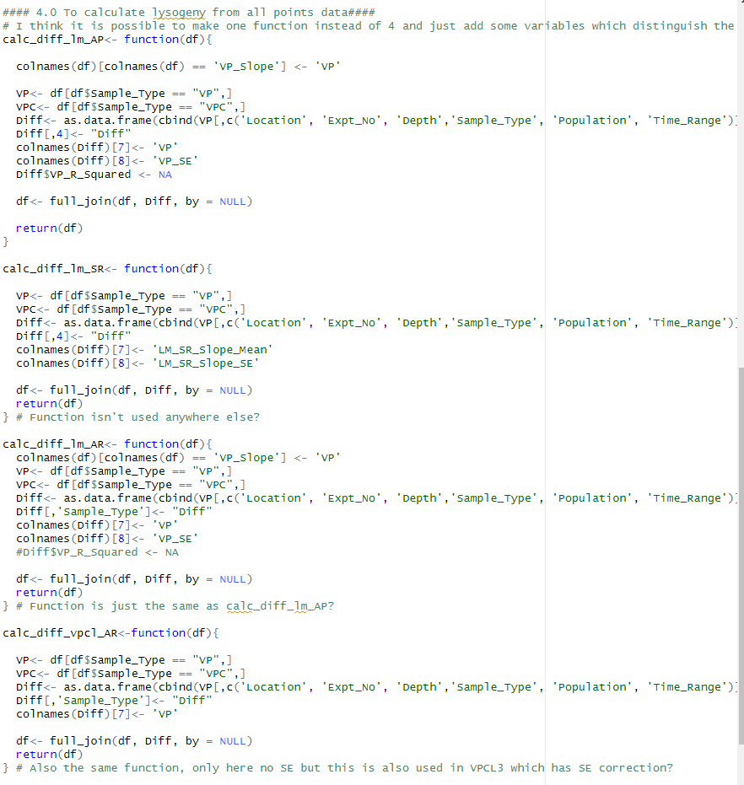
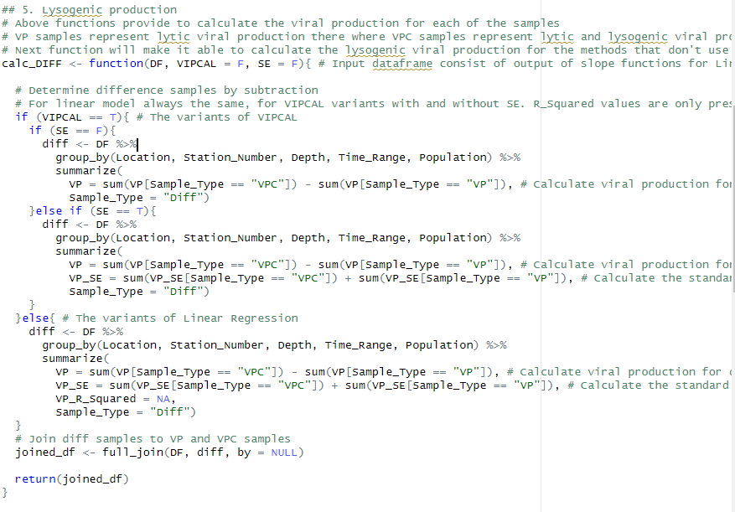

Slide 22
8. Different methods_general functions: LM_x() & VPCL_x()
These functions just refer to all the functions described before, made sure that general structure of each of the methods is the same
Added a group_by and arrange statement so that output_df always have the same structure => had some problems with the Time_Range of my diff samples => for some reason it was T17, T20, T24, T3 & T6 => fixed now
For LM-2 and VPCL-1, which have separate replicate treatment => 1 function instead of two, with variable avg = T by default. In main combine function this is set to False if you want the results for separate replicate treatment

Slide 23
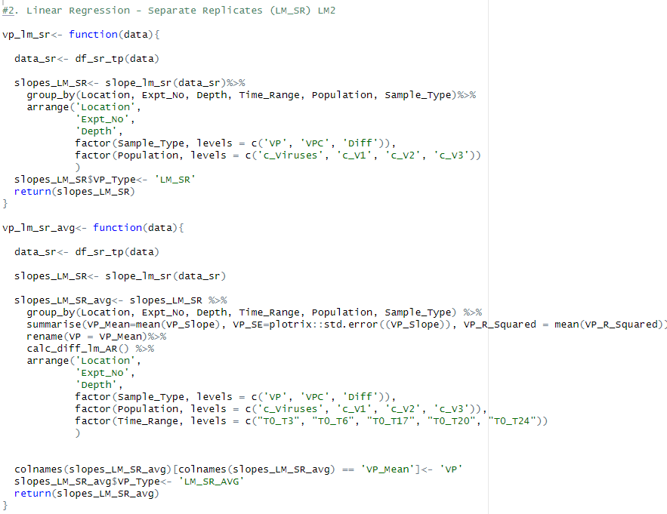
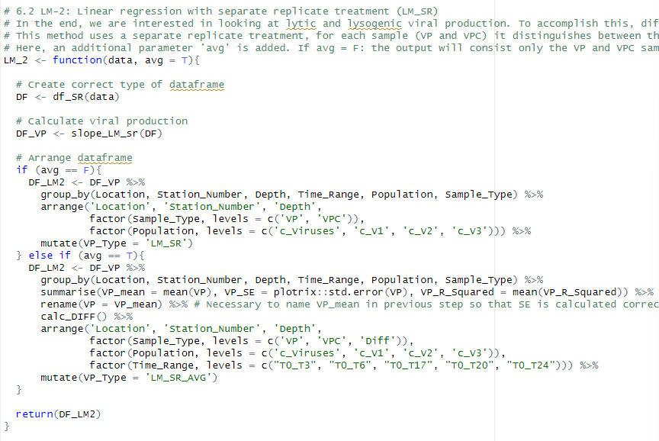

Slide 24
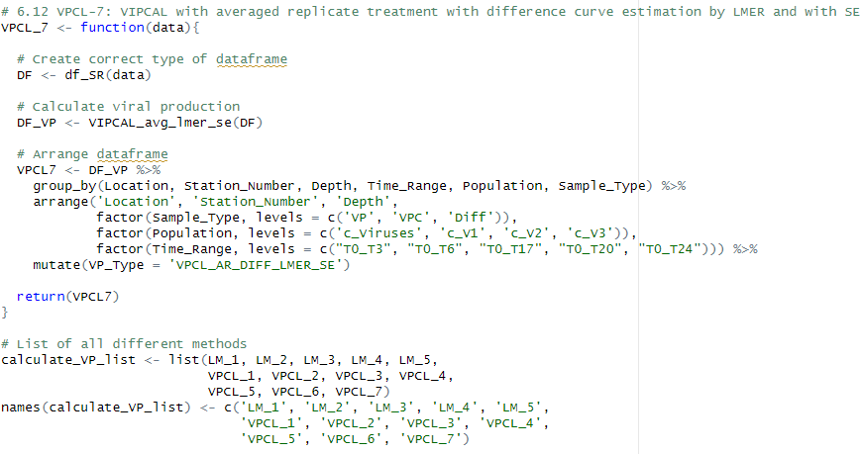
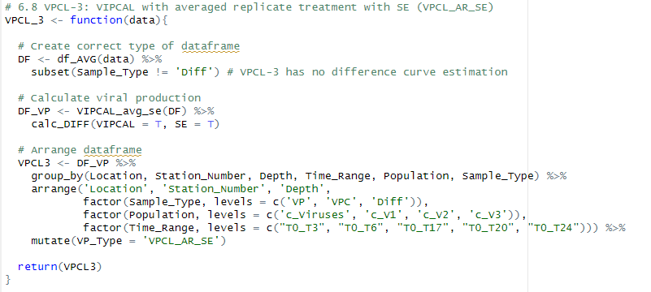
List of all different methods. Only have one list since the separate replicate treatment is incorporated in the function (no individual function). Also changed the names of the list, in combine function the name of the Method will be printed out instead of the index number

Slide 25
9. Bacterial endpoint: bacterial_endpoint()
The storing of the generation times is different => I used the same method as we did in the slope functions => store everything in a nested list and then make a data frame from it
Pivot_wider to have a more structured dataframe
Left a print statement in it so that when running this, you can see the generation times

Slide 26
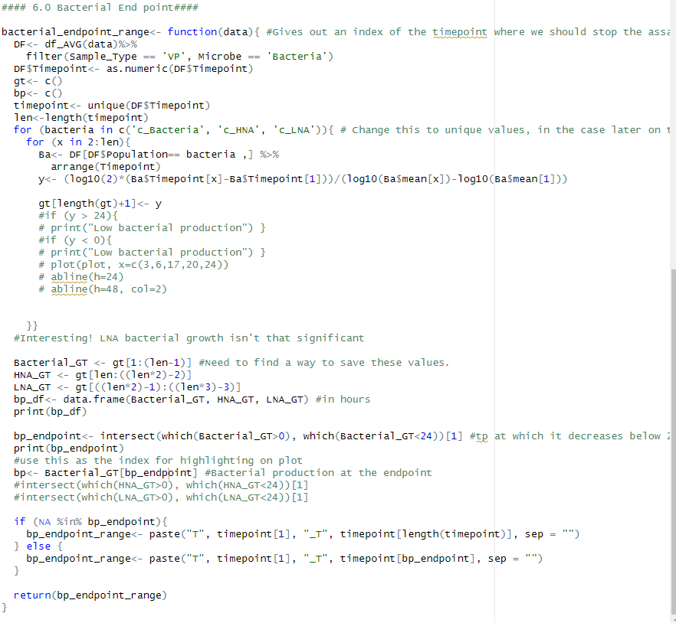
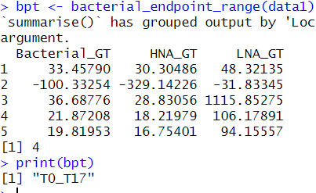

Slide 27
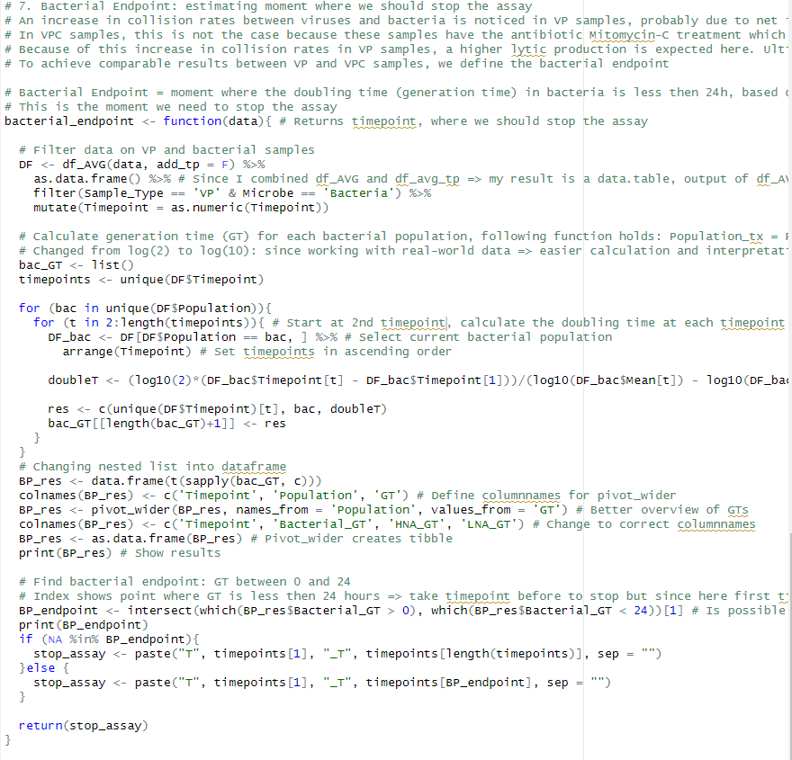
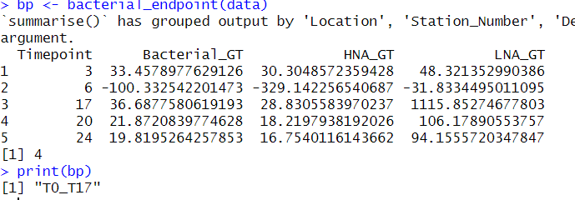

Slide 28
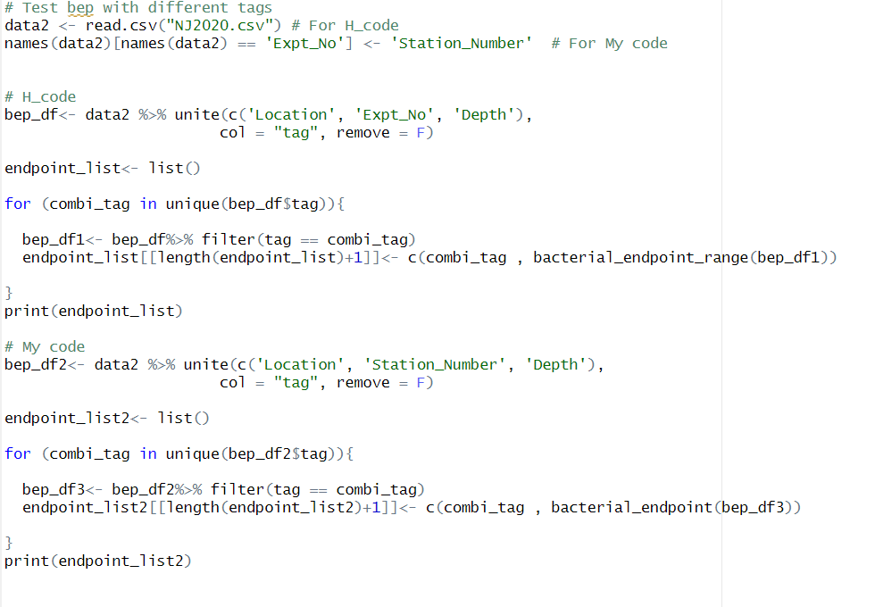


With this function I still have some issues when running the NJ2020.csv data. It is really strange since I have the same dataframes and I calculate the generation time correctly, but for some reason the wrong index is returned in some cases?
For following code:

Slide 29
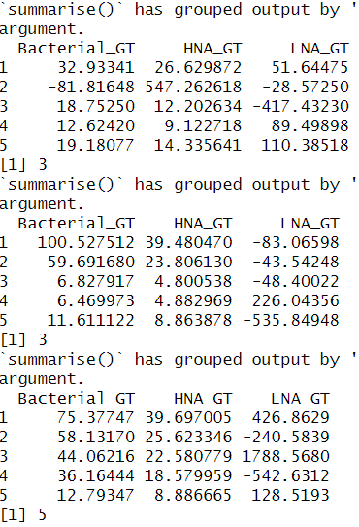
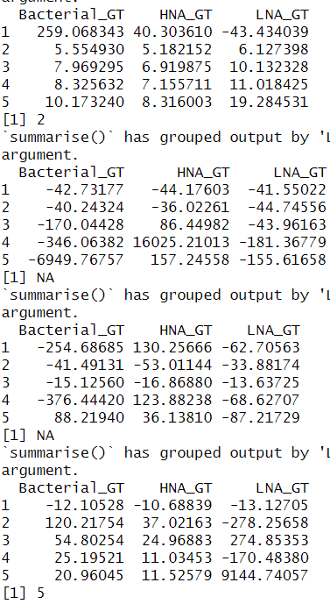
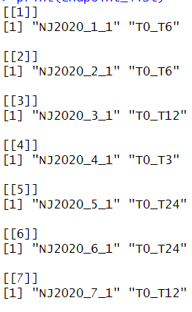









Desired result (code Hisham)

Slide 30
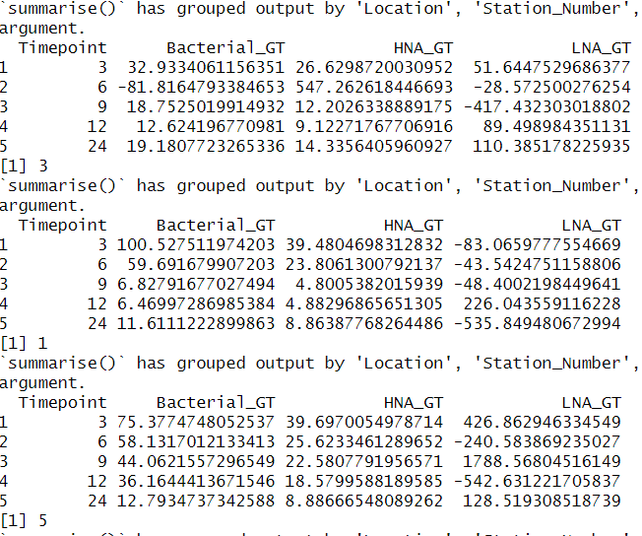
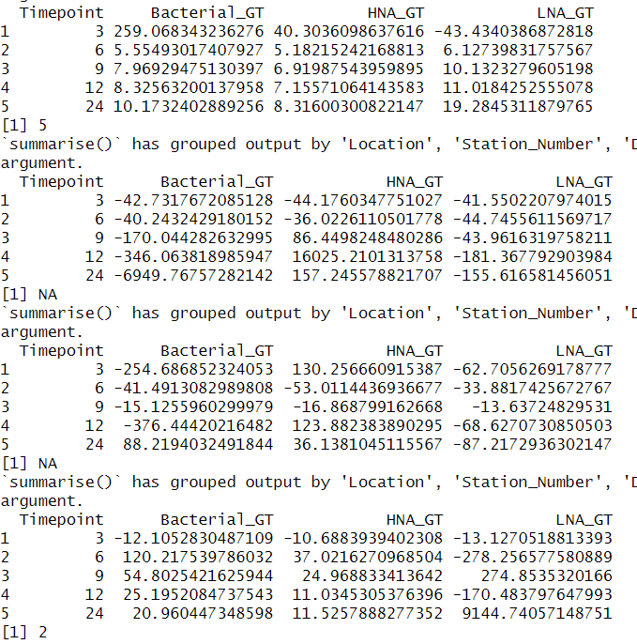
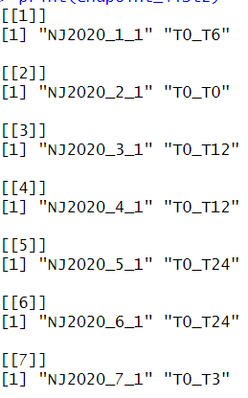









My output

Slide 31
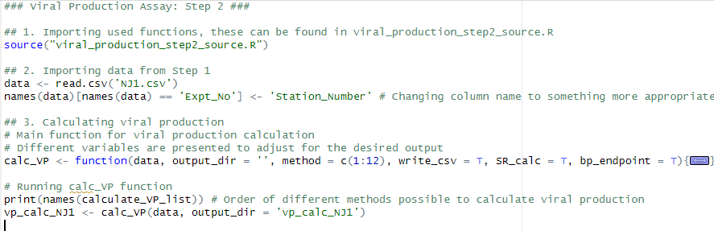
Actual File for Step 2 [viral_production_step2.R]
Consist of importing all the functions [viral_production_step2_source.R] and the data of step 1 [NJ1.csv]
The main function for calculating viral production: calc_VP()
Creating the output dataframe is done a little bit smoother by directly assigning the class type to the columns
For separate replicate treatment, I needed to define the two functions that are eligible and change the argument avg to F
General structure for handling errors and warnings is the same

Slide 32
Week 2
10/08 – 17/08

Slide 33
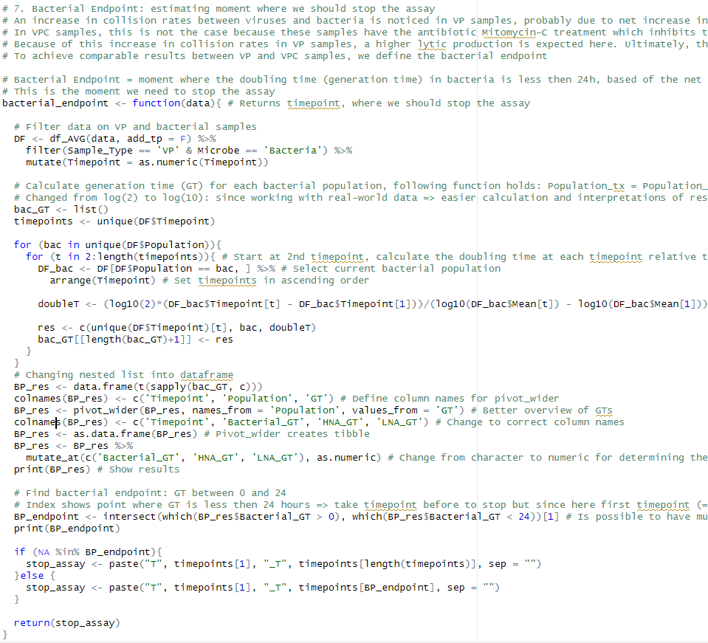
1. Fixing bacterial endpoint for NJ2020 dataset
Found the bug: when making the overview dataframe with the GTs for each bacterial population at each timepoint, it saved these values as a character and not as numeric value => because of that the intersect gave back the wrong index on some occasions

Slide 34
Successfully ran step 2 for both datasets: NJ1 and NJ2020
Results dataframes are in vp_calc_NJ1 & vp_calc_NJ2020
When you run step 2 from the start for the first time => a warning about tidyverse select(c(colnames)) => needed to add all_of => select(all_of(c(colnames)))
Removed all the factor(Time_Range,…) in arrange of the different methods => different timepoints are allowed this way
This was added to order the output dataframes

Slide 35
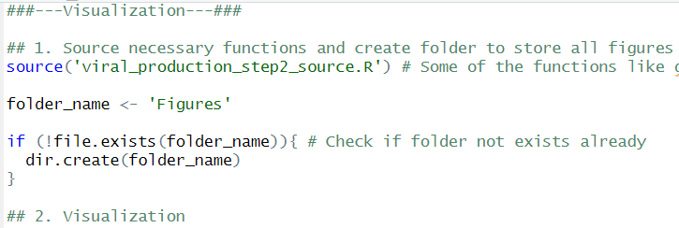
2. Visualization
Looked at two visualizations that are already there:
Overview of the input data of step2: FCM counts vs Sampling Timepoints for each population
Visual of the difference in collision rates between both samples at the different timepoints + showing the bacterial endpoint
New script for all visualizations:
Visualization.R

Slide 36
Vis1: Overview of input data
Script I found had two functions, one to visualize the points and one to highlight the bacterial endpoint
Made 1 function: overview_plot_counts_over_time()
Function plot points and highlights the bacterial endpoint in once
Did some data manipulation locally to automate the function:
Added tag to iterate through => NJ2020 dataset automatically makes figure for each combination of Location_Station_Depth
Need to make a new column Subcrobe which combines Subgroup and Microbe => otherwise I couldn’t get Total_Bacteria and Total_Viruses on the same plot
Plots are automatically saved in a folder Figures with a unique name
Station 5 and 6: total_viruses not visible on plot => looked at data and average count is higher then limit know => count 28e6, limit 16e6
Changed Bacterial_Endpoint function => visual option => index of bacterial endpoint returned instead of actual time range
See script for function

Slide 37
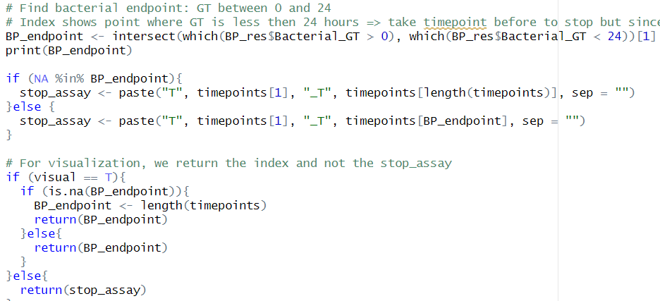

Slide 38
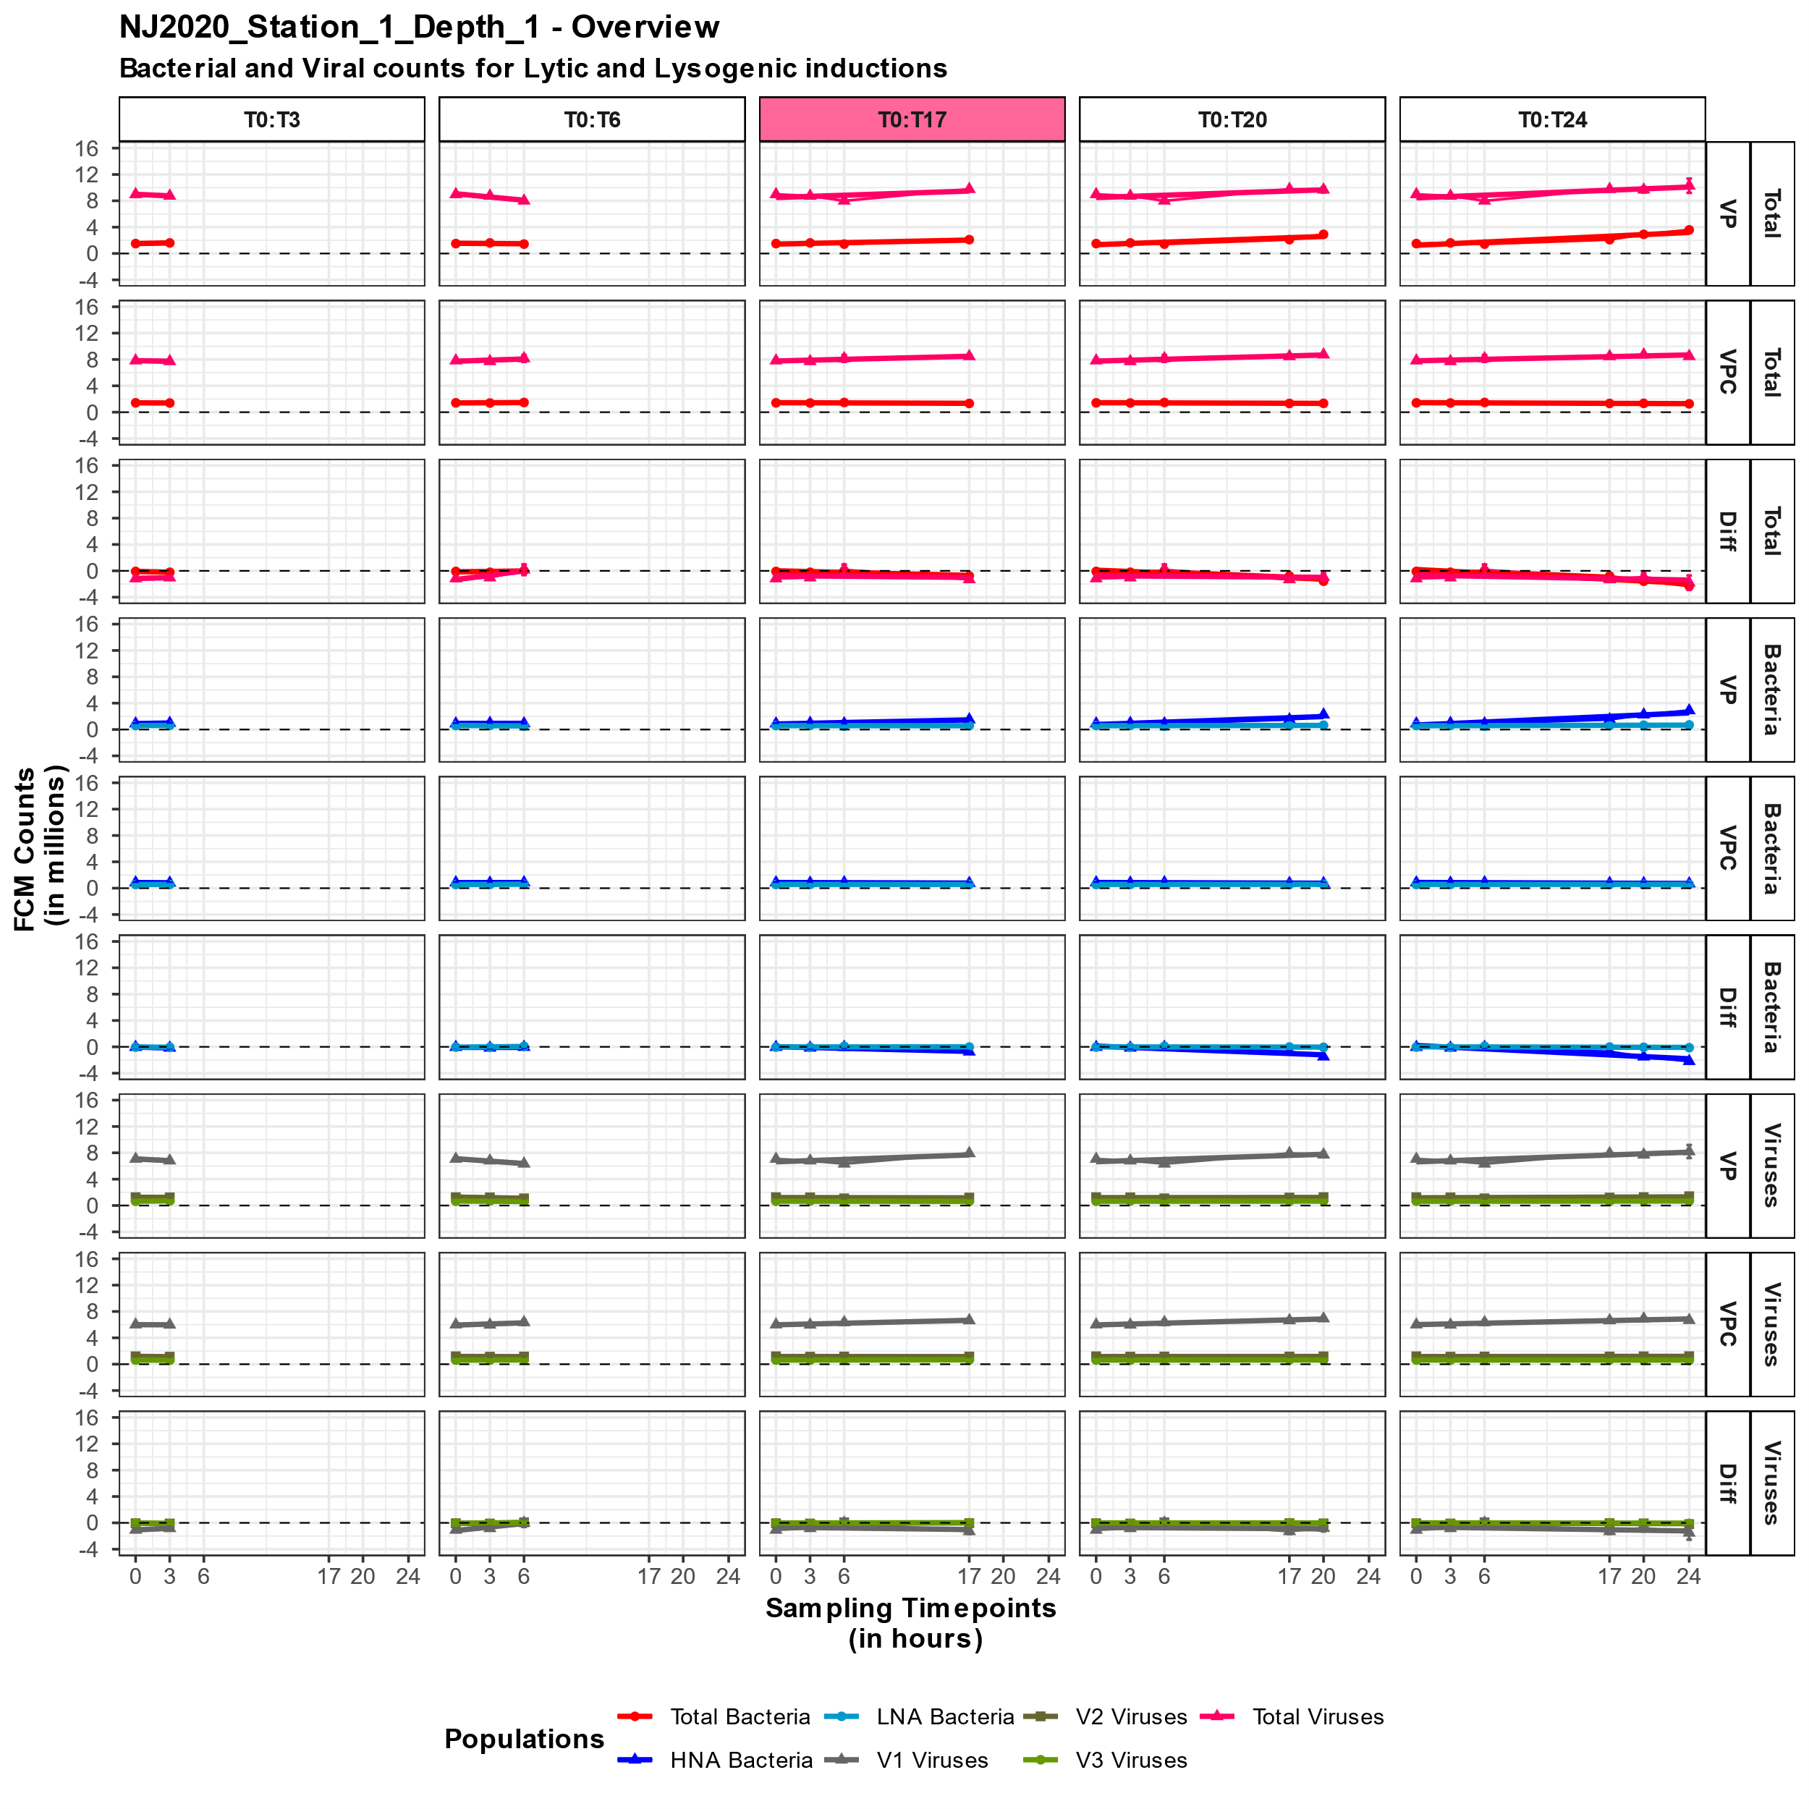
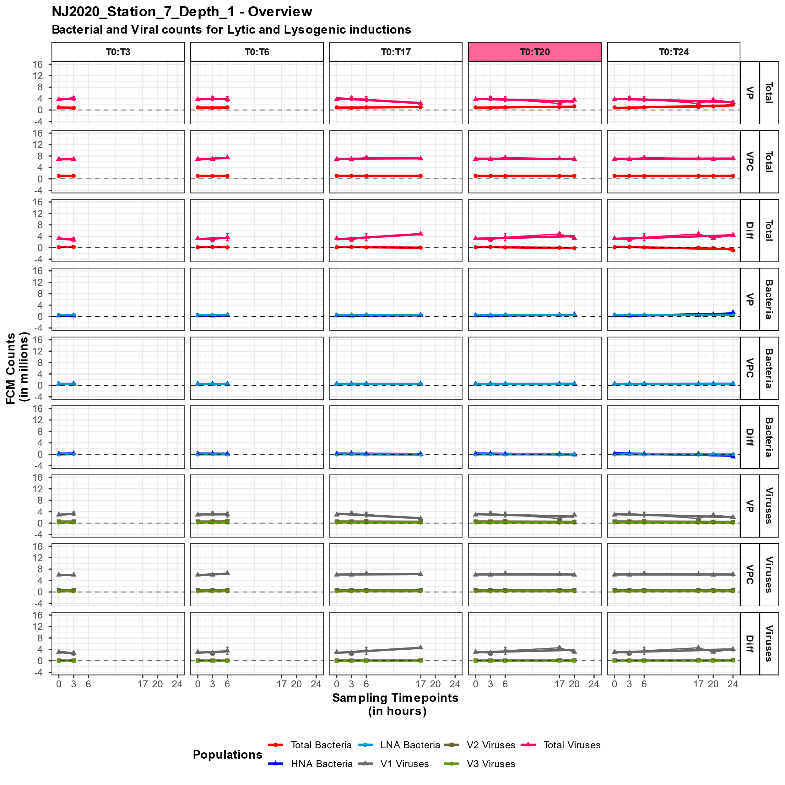

Slide 39
Vis2: Difference in collision rates
Script I found made three plots each with different legend and added them all together to one figure
Made 1 function: collision_rates_plot()
All data manipulations are now in the function
For visualization also just one ggplot object => multiple legend made with ggnewscale::new_scale_color() => collision rates, difference line and bacterial endpoint => needed to add draw_key_cust() to make sure that not both vertical and geom_line will be present in legend but separated
Added the percentual decrease in collision rates between the test sample (T0) and the original seawater sample (WW) => NJ2020_abundance.csv consist of the original abundances for each experiment (WW_sample) => (CR_WW – CR_T0) / CR_WW * 100 => added as text on figure
See script for function

Slide 40
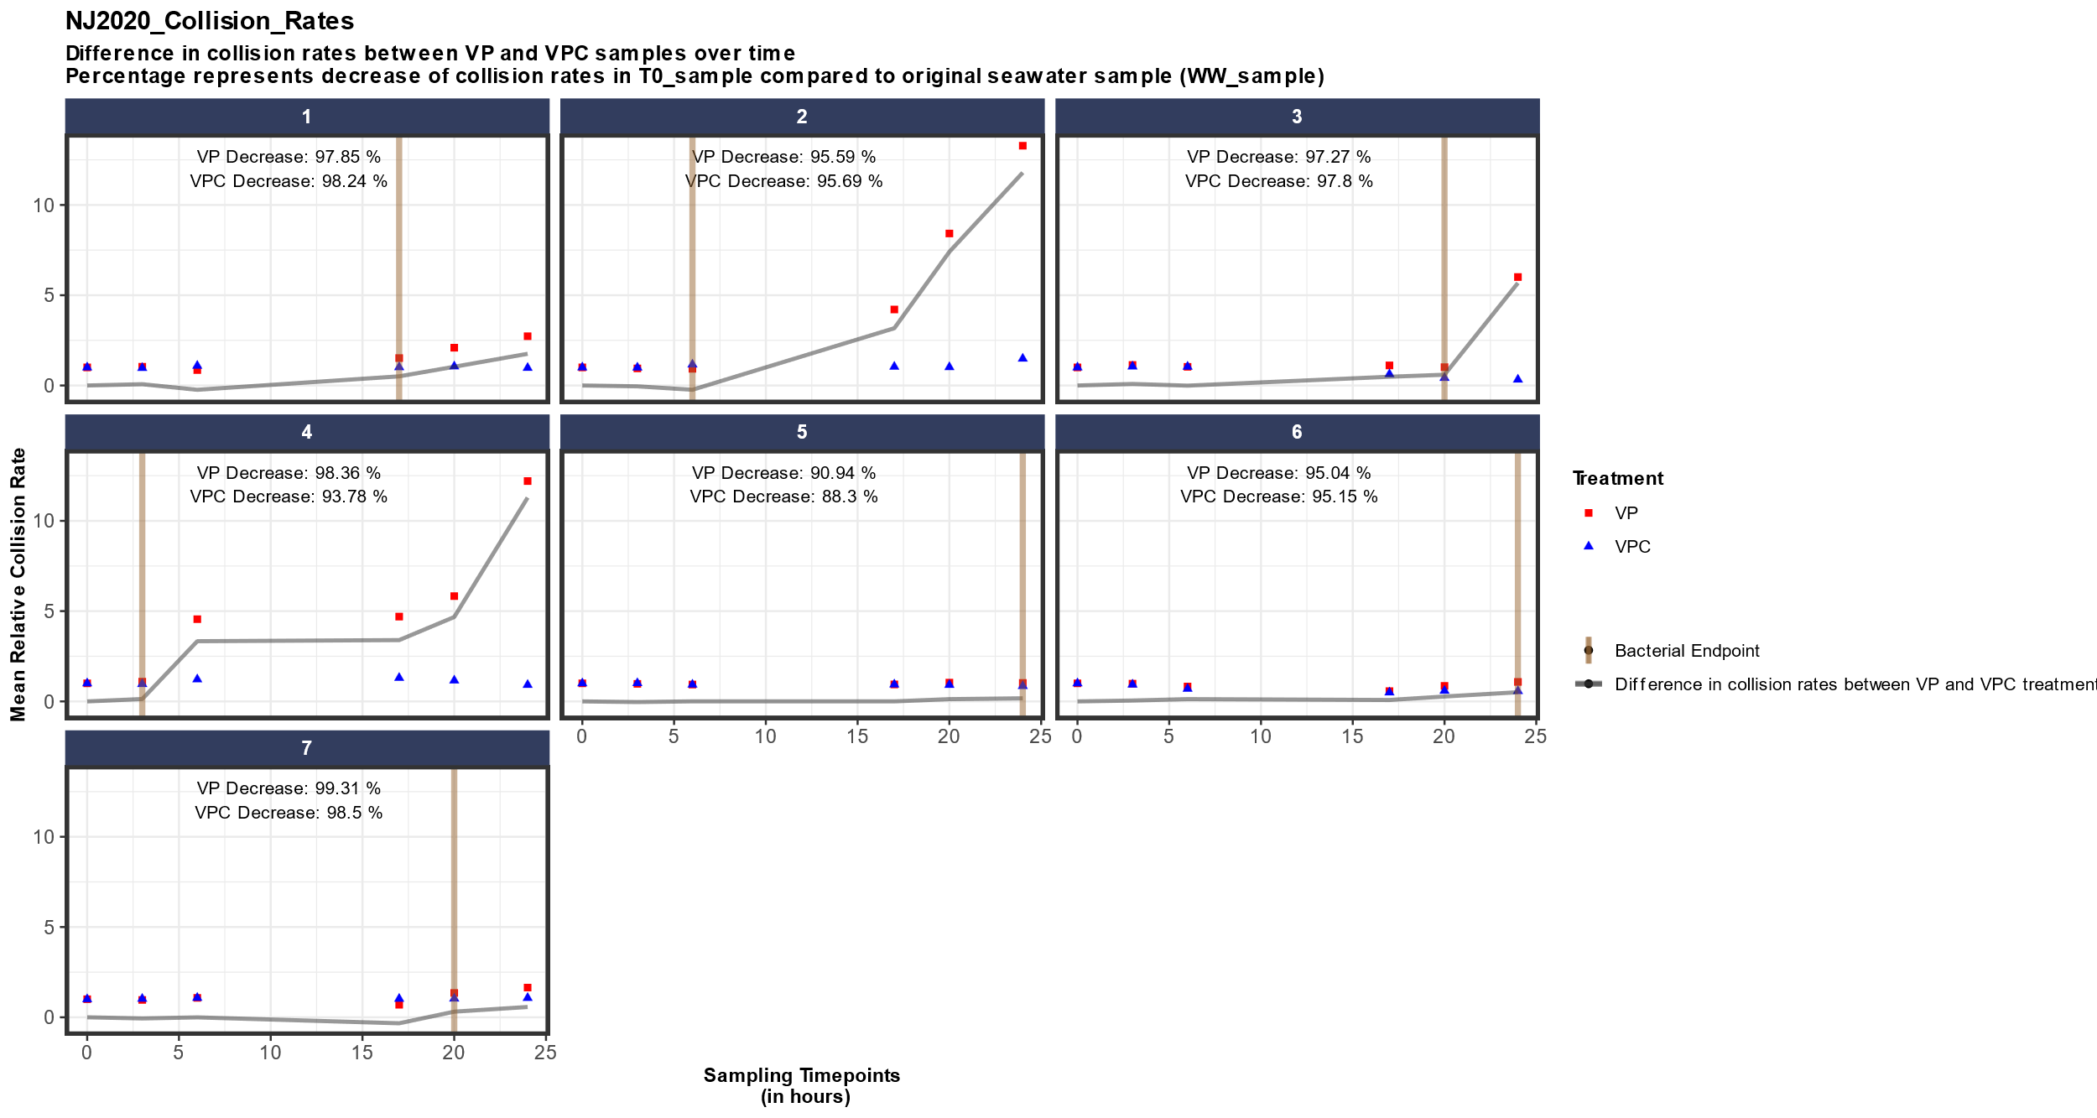

Slide 41
3. Analyzing VP_results
I change the timepoints when reading in the data: 9 -> 17; 12 -> 20 => different values were become I guess because sometimes in the arrange(), I added a factor(Timepoint) for a clearer output dataframe
Analyze_vpres() => three files necessary: vpres (output step 2), data (output step 1) & abundance (abundances original sample)
Everything is in one function, starting of from vpres dataframe and add columns with the calculations => in the end one big dataframe
Needed to add the absolute values of VP instead of rates as extra column for some of the formulas
See script for function
Next slide consist formulas used

Slide 42
Correct results: VP values represent only 40% (40% Bacteria at T0)
c_VP = VP * (B_OS/B_0)
c_SE = |c_VP| * (SE / |VP|)
Filter out VPC samples since VP (lytic fase) and Diff (lysogenic fase)
Lytic and Lysogenic VP: current corrected VP values correspond to amount VLP (virus-like particles) / mL h
for every Time_Range determine the %cells (VP = % lytically infected cells, Diff = % lysogenic cells)
Burst size: 10, 25, 40 => quick scroll through literature but couldn’t find any average values => higher burst size = lower percentage cells
Add first Bacterial abundance at T0 (B_T0)
%Cells = abs_VP * (100 / (B_T0 * BS)

Slide 43
Lysis and Lysogenic rate of bacteria
Rate for each burst size: Rate = c_VP / BS
% bacterial production lysed
%BP_Lysed = Rate / BSP_OS
NA value for Diff_samples since they represent Lysogeny
BSP_OS = bacterial secondary production => took value from VIPCAL?
% bacterial loss per day
%B_Loss = ((Rate * 100) / B_OS) * 24
Again, NA for Diff samples since %B_Loss represents the rate at which bacteria are removed due to viral lysis
Viral turnover time
First need to add V_OS = viral abundance at original sample
V_TT = c_VP/ V_OS

Slide 44

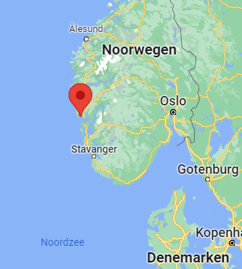
Nutrient release in bacteria and viruses: C, N, P
Bacteria:
Article from 1996 (probably too old), native bacteria were sampled from different locations in Scandinavia => Raunefjorden, Norway = just outside the North Sea
Element content for C, N and P taken from Raunefjorden, October 1993
B_DO(C/N/P) = Rate * (C/N/P)_B
Found another article! (2002)

Slide 45
Viruses:
Article from 2014, biophysical scaling model of intact virus particles that has been validated using sequence and structural information to quantify differences in element stoichiometry of marine viruses compared with their microbial hosts
Estimate the number of macromolecules of a virus particles head (capsid + genetic material) with geometric model => similar, estimation of elemental content in virus tails
Out of the table: Synechococcus (phage Syn5) is a known marine viruses => used these number of atoms of C/N/P
C/N/P_V = (C/N/P_value / N_Avogadro) * Molecular Mass
V_DO(C/N/P) = VP* (C/N/P)_V
Took here the viral turnover time or do I also need to use lysis rate of bacteria?

Slide 46
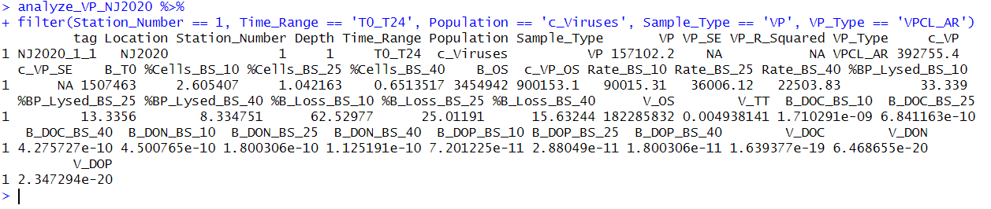

Slide 47
Week 3
18/08 – 23/08

Slide 48
Updating Step 2: some minor bugs
Every first time I run step 2: LM_AP (LM1) is not executed => warning tidyverse:: select
At every select/pivot_longer/unite needed to add all_of(c(…)) => use of external vector in selections is deprecated in tidyselect
Adding a mutate_at step in each of the methods for joining with output dataframe
Station Number keep as integer instead of character value
When doing sapply it was kept as character I guess

Slide 49
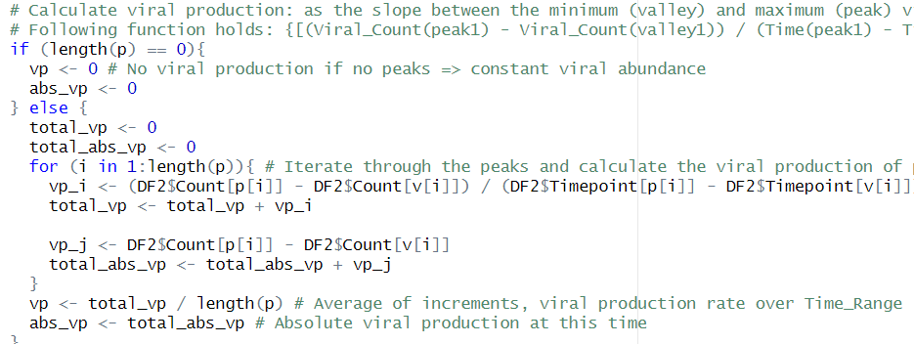
Needed to add the absolute values of VP instead of rates as extra column for some of the formulas for analyzing results
For linear regression: multiply estimate with current timerange to get absolute value
For VIPCAL: don’t divide by timerange, just take sum of increments (peaks)

Slide 50
Went again over all the functions of Step 2: Viral production calculation and everything works (with absolute vp values)
4 csv files are written:
Vp_calc_ALL = all the results for each method
Vp_calc_24 = only the T0_T24 assay results => intermediate Time_Ranges are filtered out
Vp_calc_SR = the results of separate replicate treatment (LM_2, VPCL_1) => in all csv, results of these two methods are averaged over the replicates after determining vp based on separate replicate treatment
Vp_calc_BP = results but with bacterial endpoint taken into account => taken assay results of bacterial endpoint, same way as vp_calc_24

Slide 51
Visualization
For Count overview:
Small change of y-axis => for some experiment the Total_Virus count is really high and was not visible due to limited y-axis => search for max and min value and changed axis according to that
Changed the factorization of the Time ranges within the forloop because experiments have different time ranges
For collision rates:
Fixed timepoint issues

Slide 52
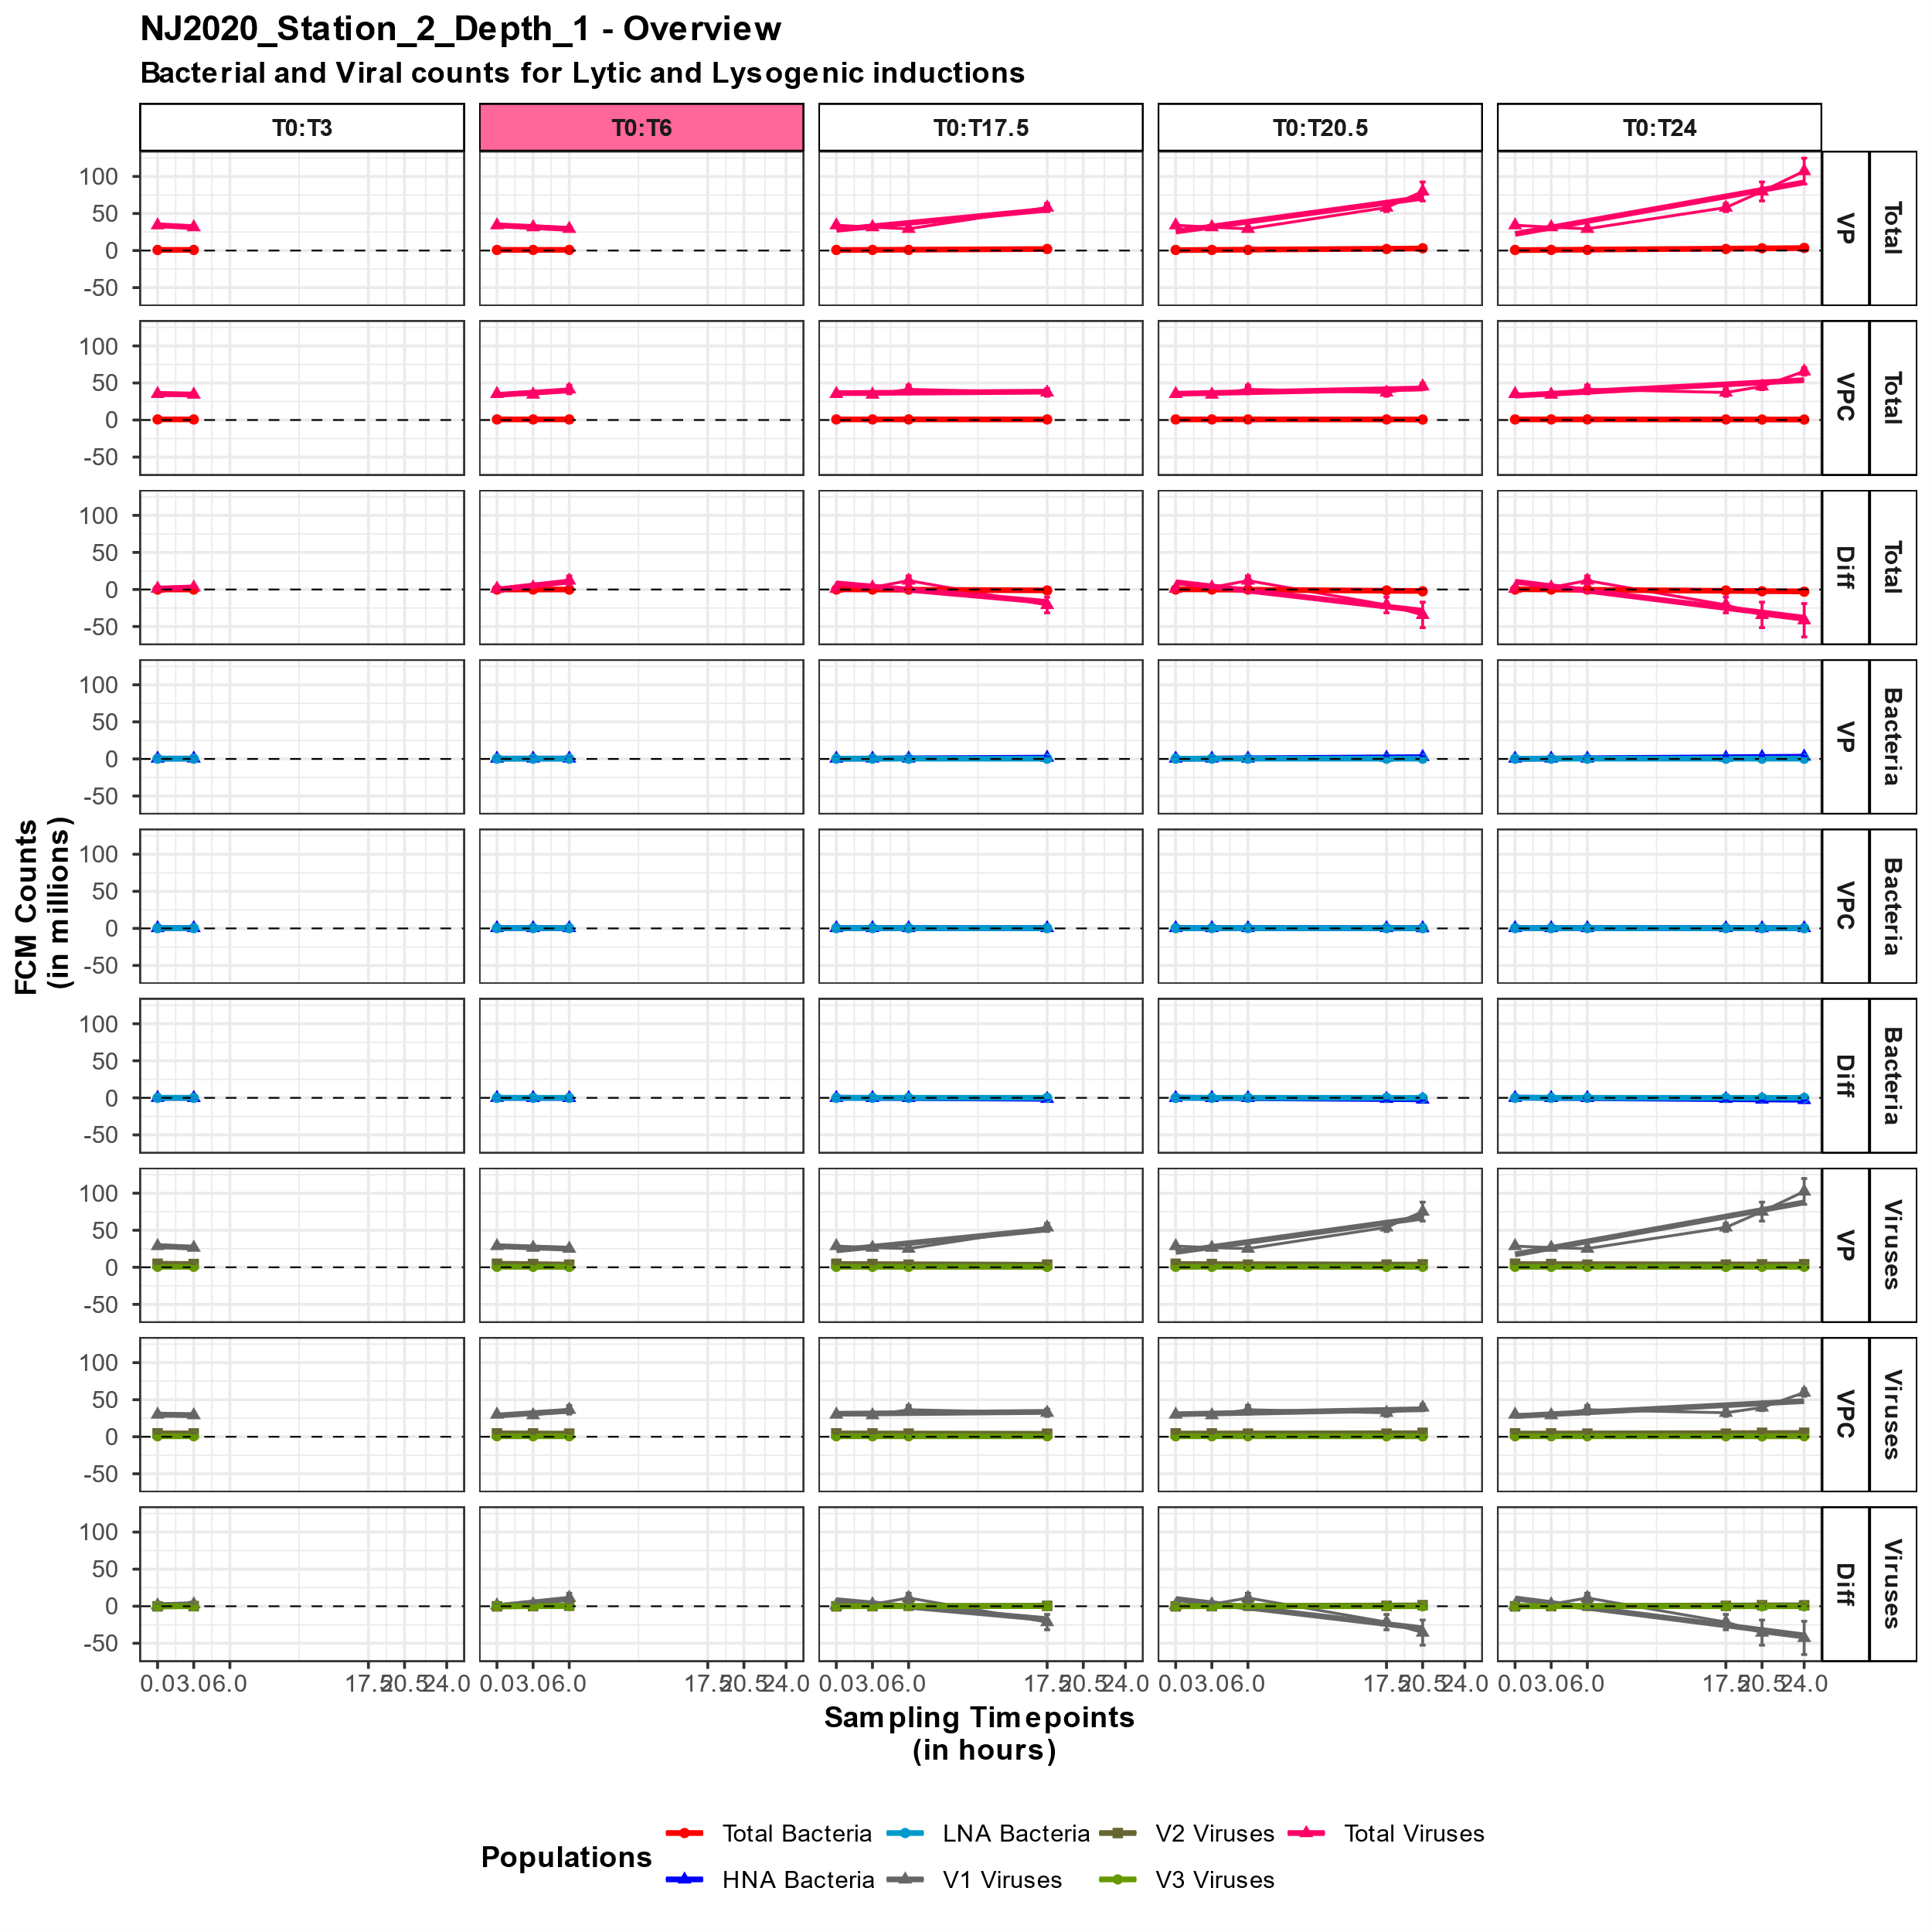
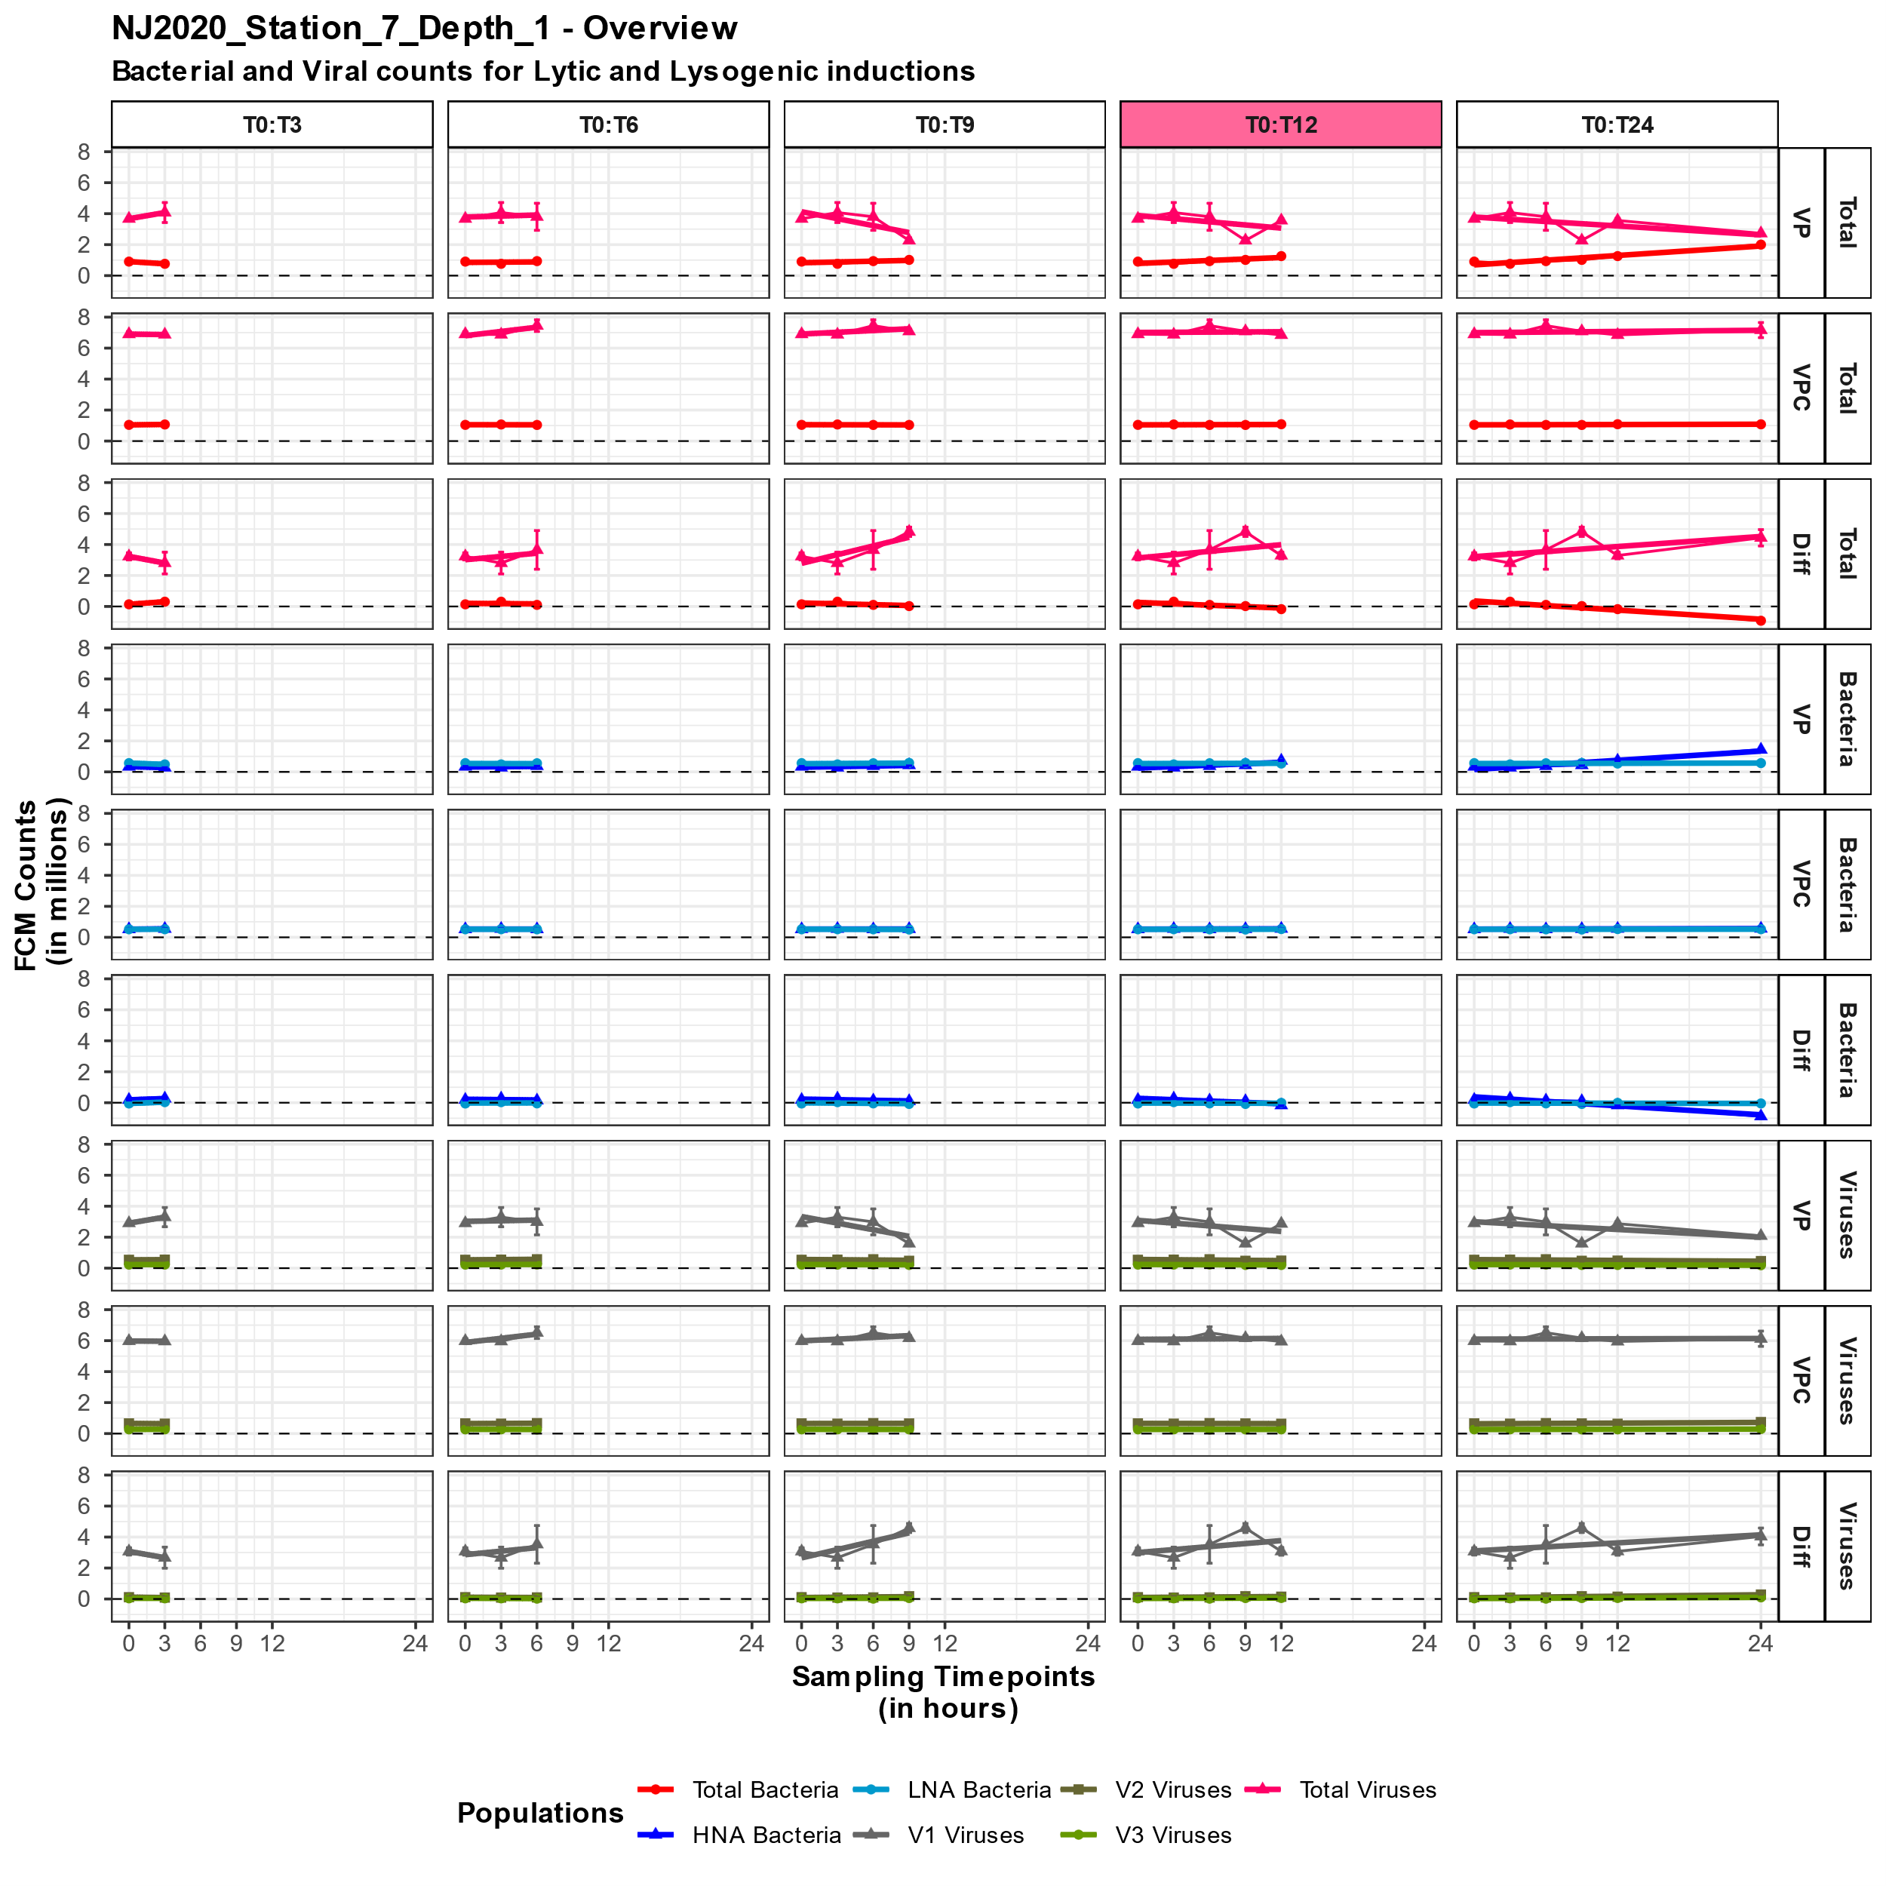
Updated figures

Slide 53


Slide 54
Analyze VP results
Did the calculations for all the data (VP, VPC and Diff samples) => some of these values are not interesting/realistic => for interpretation and visualization filter useful data
First, adding abundances of the original sample and at T0 based of input dataframes + two extra parameters: Burst Size and BSP => if these are empty, give default values
Analogue for nutrient contents in bacteria and viruses => can be given as a parameter (vector), if empty vector => take default values from mentioned articles => Are units correct?
Analogue for the nutrient content of bacteria and viruses => default values if not given as parameter => articles of default values are mentioned
Output is one big dataframe => added a column for each calculation to output dataframe of step 2

Slide 55
Analyze VP results
Added a second sheet with the description of all the variables as well as the units if present
To accomplish this, I couldn’t use write.csv but needed to use the openxlsx package => because of this an excel file and not an csv file is created
The excel file has two sheets:
Data which consists of all the observations (rows) and all the variables (columns)
Data dictionary which consist of all the variables (rows) and their description/unit if presented
Excel file is saved in the same folder as the output dataframes of step 2
Functions stops if this output folder doesn’t exist => means that step 2 is not runned yet
In step 2: saved output_dir as global variable => in analyzing first check if this folder is presented

Slide 56
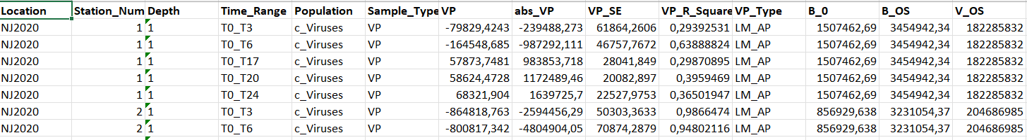
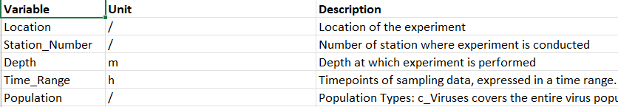
Data sheet
Data dictionary sheet

Slide 57
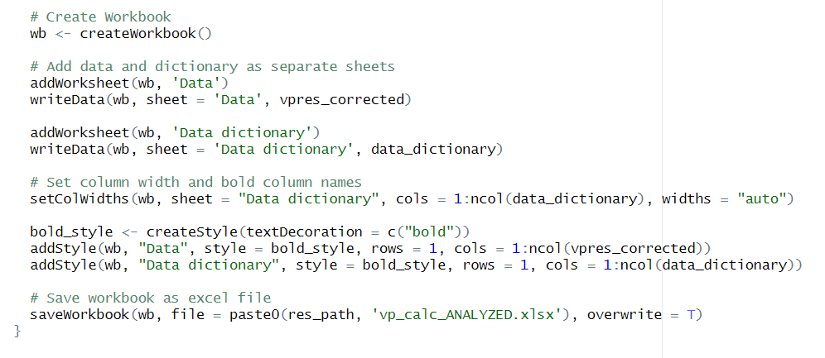
Example to have excel file with two sheets:
Saved now as two separate csv files since a csv file is more compatible

Slide 58
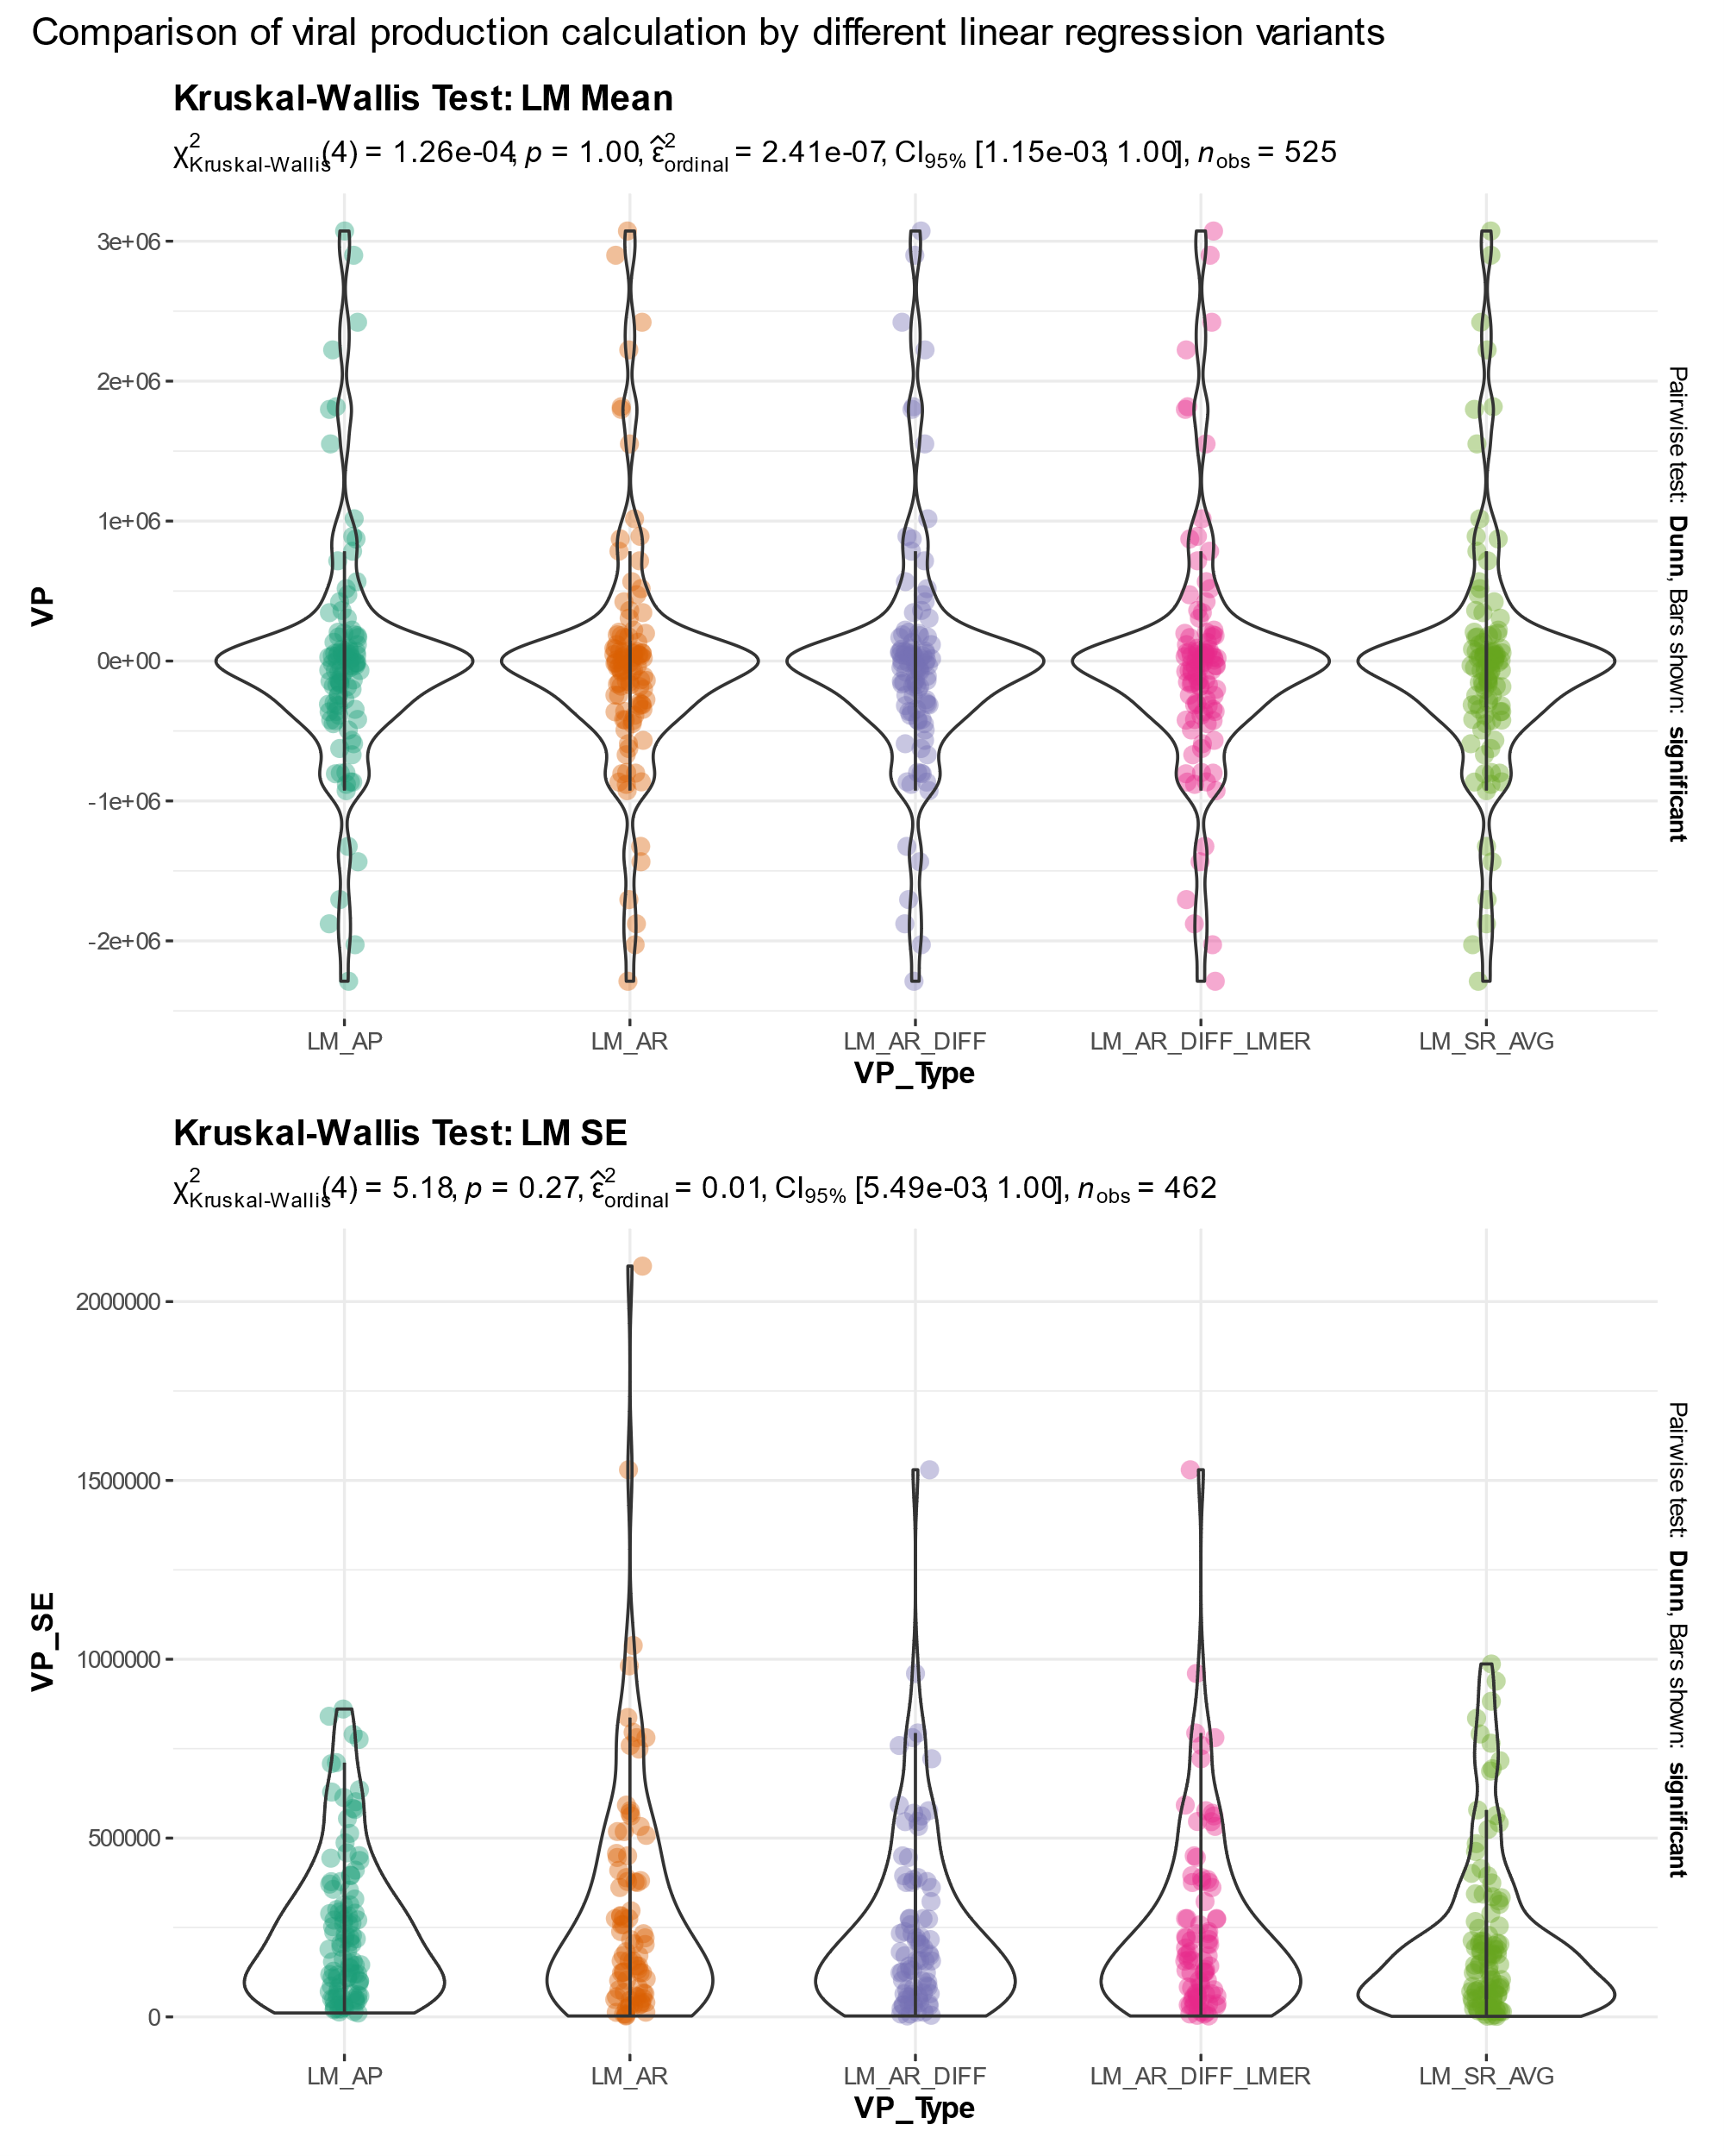
Visualizing analyzing results
Comparing results by different calculation methods via Kruskal-Wallis test: ggstatsplot::ggbetweenstats
1. Comparison of linear variants

Slide 59
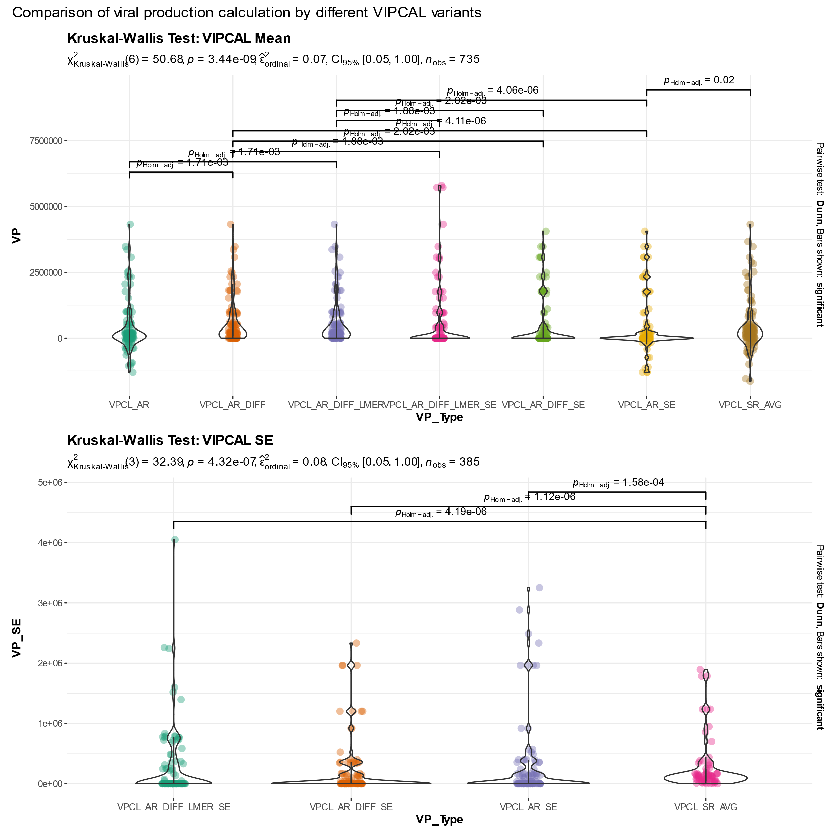
2. Comparison of VIPCAL variants

Slide 60

3. Comparison VIPCAL/VIPCAL_SE/LM (Welch test)

Slide 61

4. Overview all methods

Slide 62
Percentage cells
For different burst sizes: percentages of lytically infected or lysogenic cells over time
Changed value to 100% if the value was higher then 100, is this okay to do?
Added the absolute vp values as points, needed to rescale these and wanted to connect them with a line but this didn’t work
There is still room to improve this figure

Slide 63


Slide 64
Total nutrient release
Added in the analyze part column for total nutrient release for each burst size:
Total_DOC_BS_10 = DOC_B_BS_10 + DOC_V
Part released by bacteria + part released by virus
Higher nutrient release by lower BS? My interpretation:
A higher burst size = more virus particles are released from an infected bacterial cell
A higher burst size will lead to a lower lysis rate since it takes a longer time to rupture the bacterial cell (more viral particles needs to be produced before rupture)
A higher burst size will eventually lead to lower nutrient release => less bacterial cells rupture (= less nutrients), more viruses come free but the addition of viral nutrients is minimal compared to the amount that comes free of a bacterial cell

Slide 65


Slide 66
Make functions conform R_Package
Followed the tutorial of R Packages (2e) and created a testRPackage to get all the commands under control
Fetched down new rpgk branch from repository
For now, will only make locally changes => in R folder removed all the rscripts and made my own in correct format
Started off with setting the necessary functions in right format:
Within every function name the packagename that is used for inside functions
Roxygen documentation for every functions
Grouped the functions in different R.files => all slope functions in an Rfile, all methods in an Rfile,…

